Slide 1
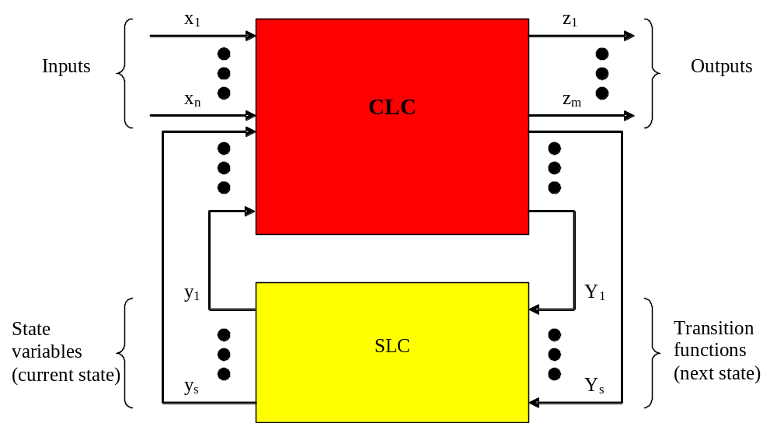
Automata in VHDL

Slide 2
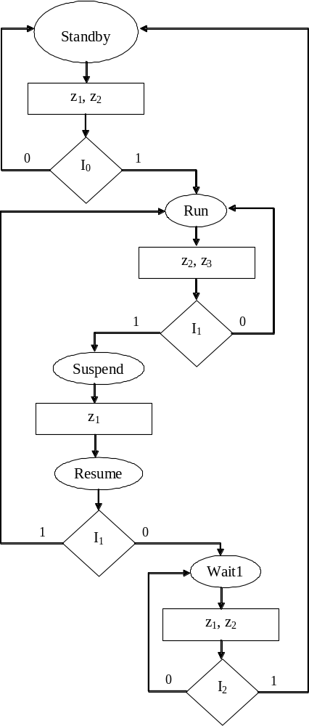
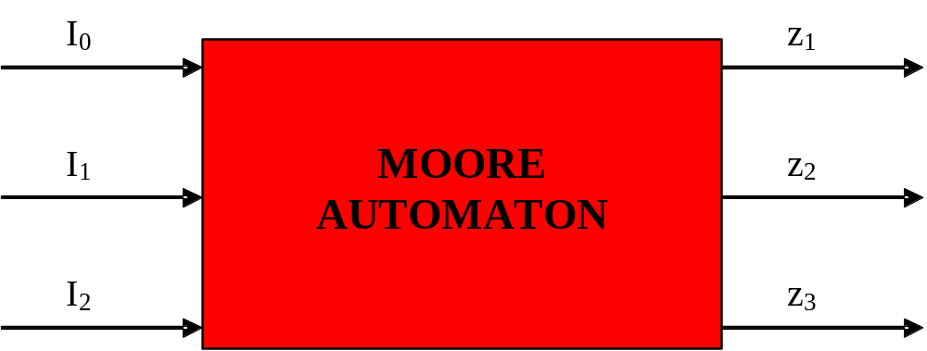
Moore Automaton

Slide 3

moore.vhd

Slide 4
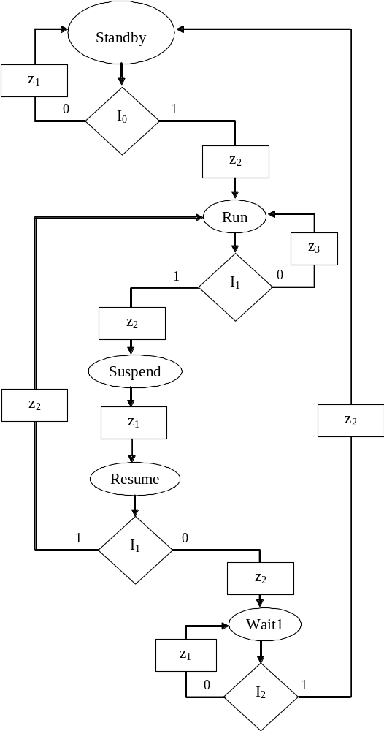
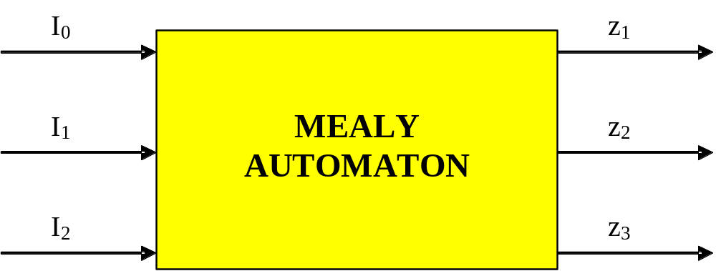
Mealy Automaton

Slide 5

Mealy Automaton
Mealy.vhd

